Slide 1
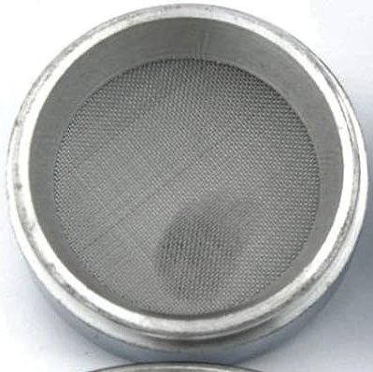

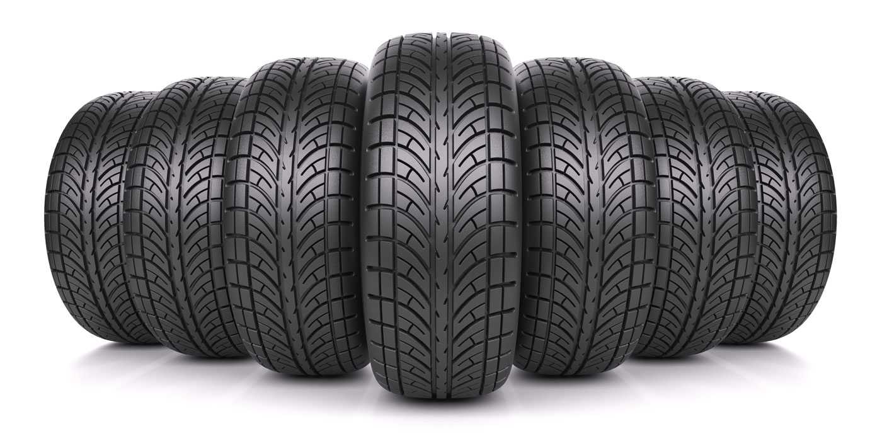
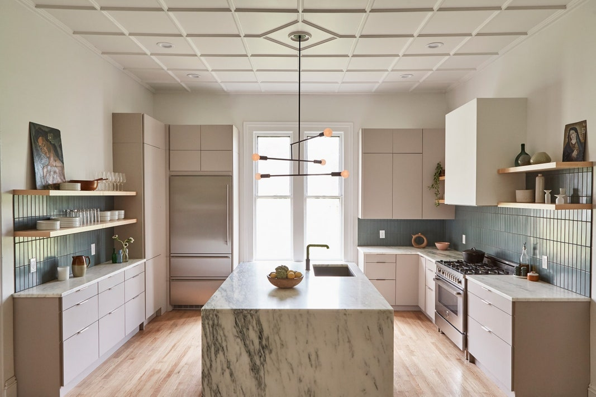

Utility Features Vision Board
Filters
Safe
Durable
Clean
Directs

Slide 2




Aesthetic Cues Vision Board
Minimalist
Smooth
Natural
Natural
Inconspicuous

